Slide 1

MACHINE LEARNING

Slide 2

Recap
From Methodology to Workflow
Data Science Workflow
EDA
Case Study
Assignment
Study Kit

Slide 3

Objectives
Introduction to Machine Learning
Understand the concept of machine learning
Types of Machine Learning
Machine learning workflow
Practice Lab

Slide 4

Introduction to ML

Slide 5
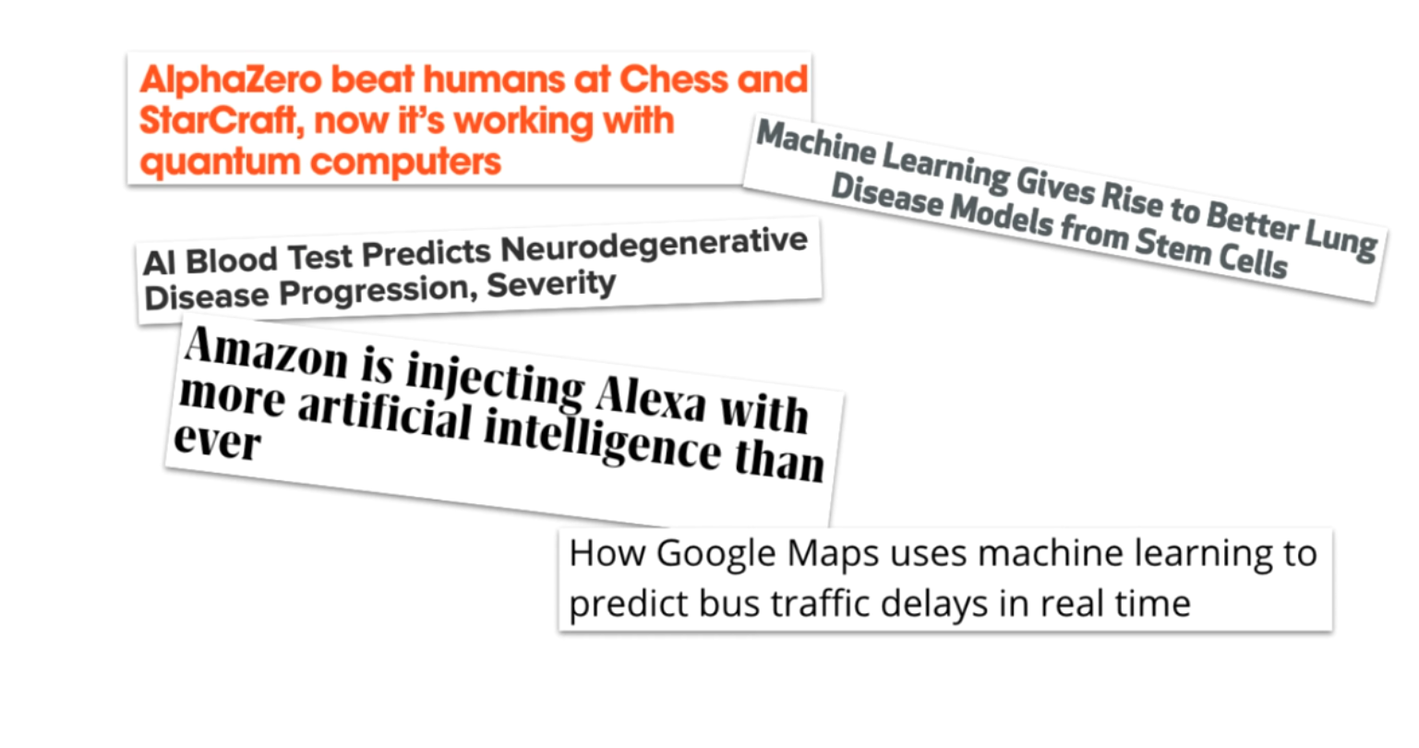

Slide 6
Artificial Intelligence
Artificial Intelligence
A huge set of tools for making computer behave intelligently
ML
Machine Learning is the most prevalent subset of AI

Slide 7

Defining machine learning:
A set of tools for making inferences and predictions from data

Slide 8
Defining machine learning: What can it do?
Predict future events
Will it rain tomorrow?
Yes (75% probability)
Inference is more vague because it’s about drawing insights
Infer the causes of events and behaviors
Why does it rain?
Time of the year, humidity levels, temperature, location, etc
Infer patterns
What are the different types of weather conditions?
Rain, sunny, overcast, fog, etc

Slide 9
Defining machine learning: How does it work?
Interdisciplinary mix of statistics and computer science
Ability to learn without being explicitly programmed
Learn patterns from existing data and applies it to new data
Relies on high-quality data
…more

Slide 10
Data Science
Data Science is about discovering and communicating insights from data
Artificial Intelligence
ML
ML is often an important tool for data science work
Data Science

Slide 11
In practice!
A statistical representation of a real-world process based on data
Outcome
New Input
Model

Slide 12
Machine learning model
Traffic conditions
Future date
Model

Slide 13
Probability it’s fake
tweet
Model

Slide 14
Important concepts

Slide 15
Three types of Machine Learning
Reinforcement learning
Used for deciding sequential actions
Supervised learning
Unsupervised learning

Slide 16
Training Data
Training data: existing data to learn from
Training a model: when a model is being built from training data
Can take nanoseconds to weeks

Slide 17
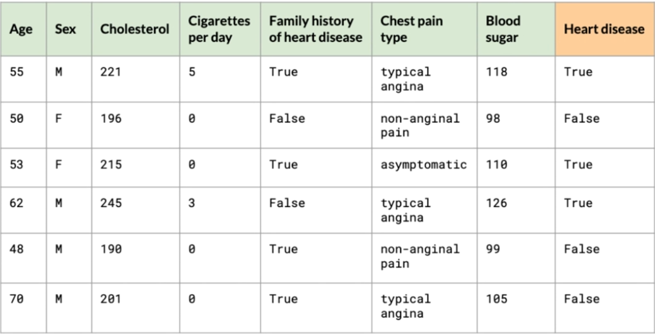
Supervised learning training data
Target Variable
Labels

Slide 18
Features
Observations

Slide 19
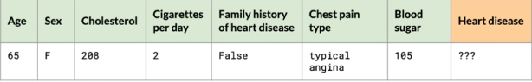
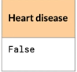
After training (supervised learning)

Slide 20
Supervised vs Unsupervised learning
Supervised learning
Training data is labeled
Unsupervised learning
Training data only has features
Useful for:
Anomaly detection
Clustering, e.g. dividing data into groups

Slide 21
Machine Learning Workflow
Machine Learning Model
Historical data

Slide 22

Our scenario
Our dataset: NYC property sales from 2015-2019
Includes:
Square feet
Neighborhood
Year built
Sale price
And more!
Our target: Sale price

Slide 23

Step 1: Extract features
Raw data
1. Extract features

Slide 24
Step 2: Split dataset
Raw data
Test dataset
1. Extract features
2. Split dataset
Train data

Slide 25
Step 3: Train model
Raw data
Test dataset
1. Extract features
2. Split dataset
Train data
3. Train model

Slide 26
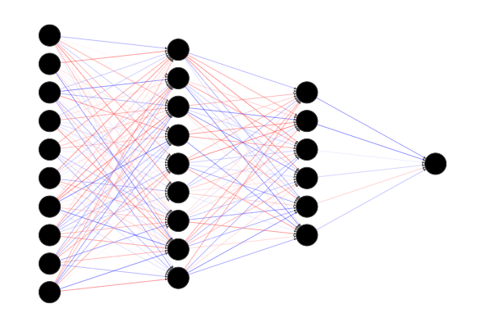
Step 3: Train model
Inputted into
Data
ML Algorithm
Trained Model

Slide 27
Step 4: Evaluate
Raw data
Test dataset
1. Extract features
2. Split dataset
Train data
3. Train model
4. Evaluate

Slide 28
Step 4: Evaluate
Test dataset
Evaluate predictions
Test dataset: “unseen” data
Many ways to evaluate model prediction:
What is the average error of the predictions?
What percent of the apartments did the model accurately predict within a 10% margin?

Slide 29
Step 4: Evaluate
3. Train model
4. Evaluate
Is the performance good enough?
No
Yes
If not, tune the model and re-train it:
E.g., change the model’s options, add/remove features

Slide 30
30
Machine learning workflow
Raw data
Test dataset
1. Extract features
2. Split dataset
Train data
3. Train model
4. Evaluate

Slide 31
Summary of steps
Extract features
Choosing features and manipulating the dataset
Split the dataset
Train and test dataset
Train model
Input dataset into a machine learning algorithm
Evaluate
If desired performance isn’t reached: tune the model and repeat Step3

Slide 32
PRACTICE LAB

